Slide 1
Regular Meeting
Raindrop Model Description
Lihui Ji
July 6, 2021

Slide 2
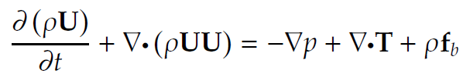



Governing Equations
Navier Stokes Equation:
T is deviatoric viscous stress tensor:
S is mean rate stress tensor:
f_{b} is body force per unit mass (surface tension)

Slide 3

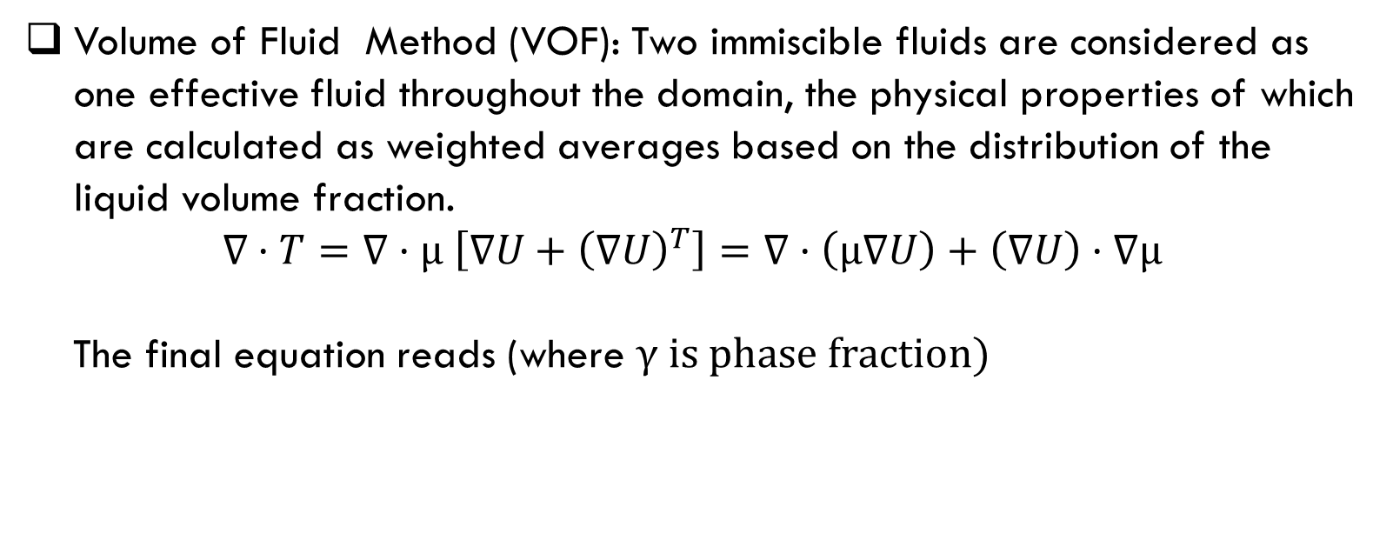
Governing Equations
Volume of Fluid Method (VOF): Two immiscible fluids are considered as one effective fluid throughout the domain, the physical properties of which are calculated as weighted averages based on the distribution of the liquid volume fraction.
$$∇·T=∇·μ \left[∇U+{\left(∇U\right)}^{T}\right]=∇·\left(μ∇U\right)+\left(∇U\right)·∇μ$$
The final equation reads (where γ is phase fraction)

Slide 4
Finite Volume Method
In finite volume method, the domain is divided to small control volumes. The value is stored in the center point of control volume (P in Figure 1). Each cell has neighbor cells which shares one face. One face can be shared by only two cells. The face (f) belongs to only one cell, which is the face owner (P), the cell that shares the face is denoted as neighbor (N). The face vector is perpendicular to it, pointing outside of owner.

Slide 5
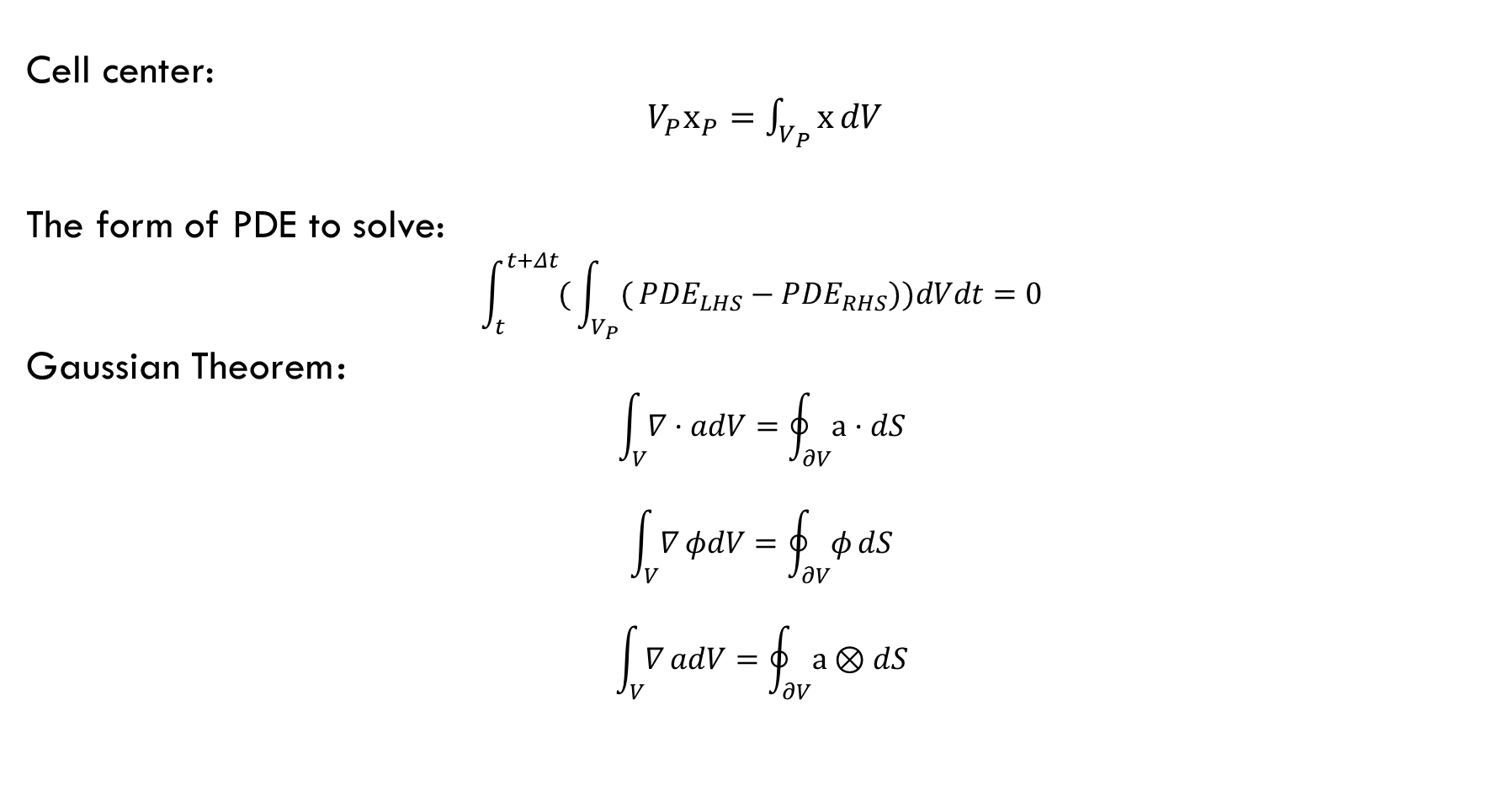
Finite Volume Method
Cell center:
$V_{P}x_{P}=\int_{V_{P}}^{​}{x}dV$
The form of PDE to solve:
$$\int_{t}^{t+Δt}{(}\int_{V_{P}}^{​}{(}PDE_{LHS}−PDE_{RHS}))dVdt=0$$
Gaussian Theorem：
$$\int_{V}^{​}{∇}·adV=\oint_{∂V}^{​}{a}·dS$$
$$\int_{V}^{​}{∇}φdV=\oint_{∂V}^{​}{φ}dS$$
$$\int_{V}^{​}{∇}adV=\oint_{∂V}^{​}{a}⊗dS$$

Slide 6
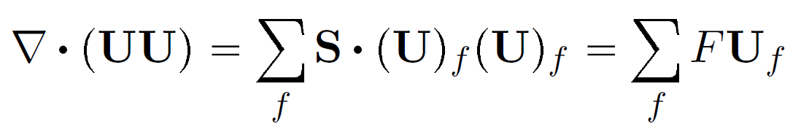

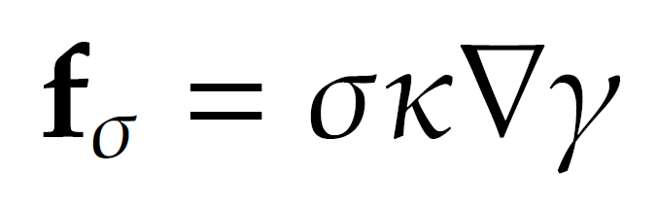
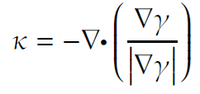
Discretization
Advection Term:
Diffusion Term:
Surface Tension:
curvature:

Slide 7
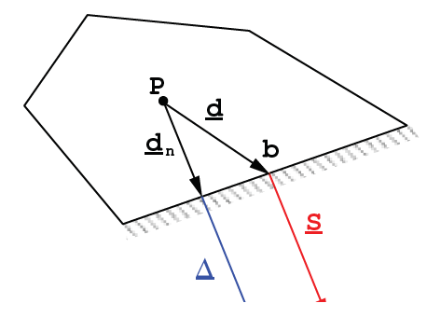
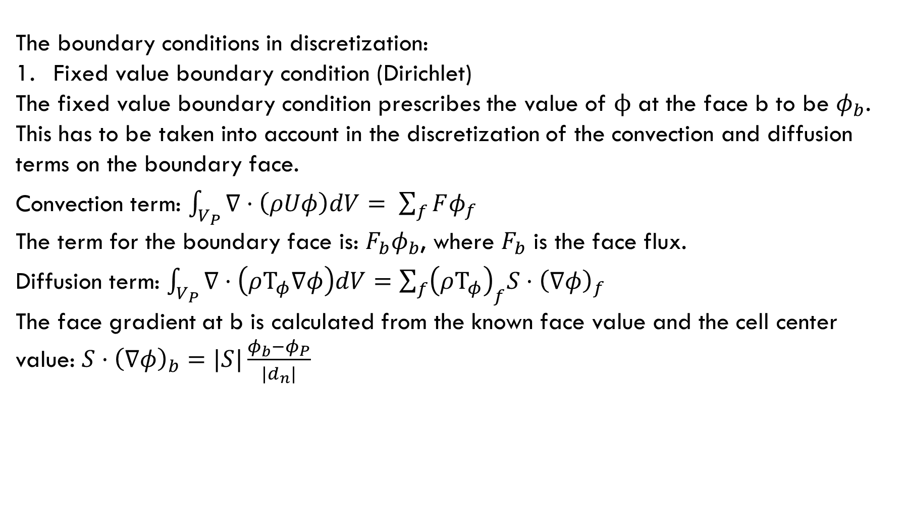
Discretization
The boundary conditions in discretization:
Fixed value boundary condition (Dirichlet)
The fixed value boundary condition prescribes the value of $ϕ$ at the face b to be $φ_{b}$. This has to be taken into account in the discretization of the convection and diffusion terms on the boundary face.
Convection term: $\int_{V_{P}}{∇·\left(ρUφ\right)dV= \sum_{f}{Fφ_{f}}}$
The term for the boundary face is: $F_{b}φ_{b}$, where $F_{b}$ is the face flux.
Diffusion term: $\int_{V_{P}}{∇·\left(ρΤ_{φ}∇φ\right)dV=\sum_{f}{{\left(ρΤ_{φ}\right)}_{f}S·{\left(∇φ\right)}_{f}}}$
The face gradient at b is calculated from the known face value and the cell center value: $S·{\left(∇φ\right)}_{b}=|S|\frac{φ_{b}−φ_{P}}{|d_{n}|}$

Slide 8
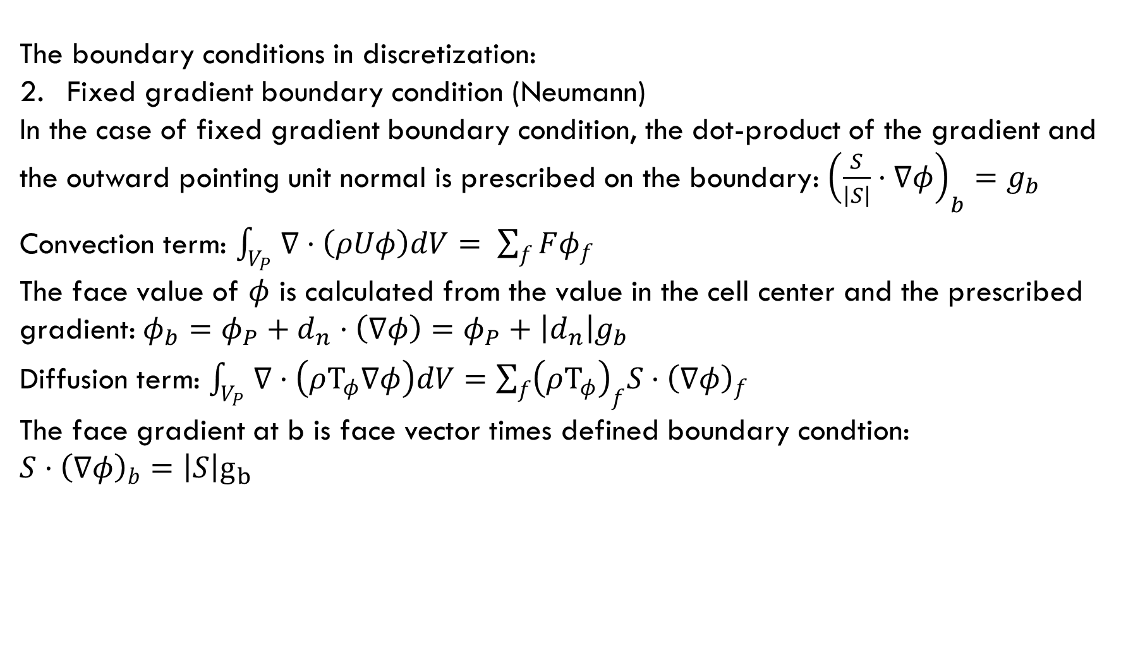
Discretization
The boundary conditions in discretization:
Fixed gradient boundary condition (Neumann)
In the case of fixed gradient boundary condition, the dot-product of the gradient and the outward pointing unit normal is prescribed on the boundary: ${\left(\frac{S}{\left|S\right|}·∇φ\right)}_{b}=g_{b}$
Convection term: $\int_{V_{P}}{∇·\left(ρUφ\right)dV= \sum_{f}{Fφ_{f}}}$
The face value of $φ$ is calculated from the value in the cell center and the prescribed gradient: $φ_{b}=φ_{P}+d_{n}·\left(∇φ\right)=φ_{P}+\left|d_{n}\right|g_{b}$
Diffusion term: $\int_{V_{P}}{∇·\left(ρΤ_{φ}∇φ\right)dV=\sum_{f}{{\left(ρΤ_{φ}\right)}_{f}S·{\left(∇φ\right)}_{f}}}$
The face gradient at b is face vector times defined boundary condtion:
$$S·{\left(∇φ\right)}_{b}=\left|S\right|g_{b}$$

Slide 9



Discretization
The semi discretized equation with advection & diffusion:
Pressure Term:
where

Slide 10

Physical Boundary Conditions
Water fraction: Inletoutlet
The inletOutlet condition is one derived from mixed, which switches between zeroGradient when the fluid flows out of the domain at a patch face, and fixedValue, when the fluid is flowing into the domain. For inflow, the inlet value is specified by an inletValue entry.
Velocity: pressureInletOutletVelocity
This velocity inlet/outlet boundary condition is applied to pressure boundaries where the pressure is specified. A zero-gradient condition is applied for outflow (as defined by the flux); for inflow, the velocity is obtained from the patch-face normal component of the internal-cell value.
P_rgh: totalPressure (uniform 80000)
P: Calculated from P_rgh (total pressure)

Slide 11
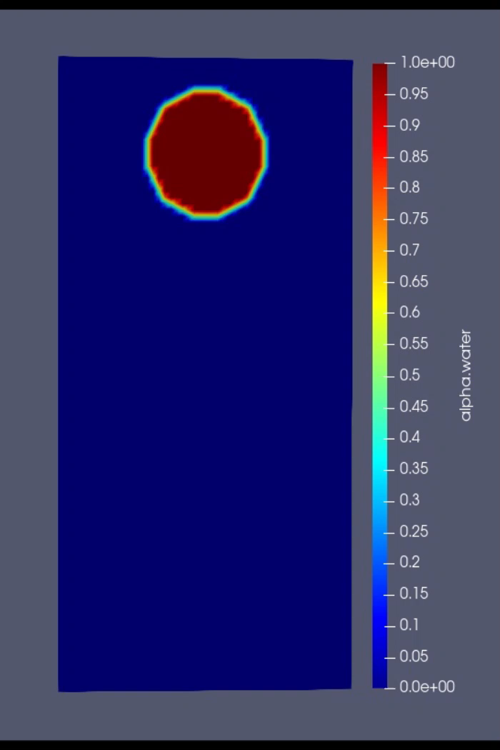
Demo of Boundary settings

Slide 12
Discretize Schemes
ddtSchemes
{
default Euler;
}
gradSchemes
{
default Gauss linear;
}
divSchemes
{
div(rhoPhi,U) Gauss linearUpwind grad(U);
div(phi,alpha) Gauss interfaceCompression vanLeer 1;
div(phi,k) Gauss upwind;
div(phi,epsilon) Gauss upwind;
div(((rho*nuEff)*dev2(T(grad(U))))) Gauss linear;
}
laplacianSchemes
{
default Gauss linear corrected;
}
interpolationSchemes
{
default linear;
}
snGradSchemes
{
default corrected;
//Central-difference snGrad scheme with non-orthogonal correction
}

Slide 13
Solver Parameters
solvers
{
"alpha.water.*"
{
nAlphaCorr 2;
nAlphaSubCycles 1;
MULESCorr yes;
nLimiterIter 3;
solver smoothSolver;
smoother symGaussSeidel;
tolerance 1e-8;
relTol 0;
}
PIMPLE
{
momentumPredictor no;
nOuterCorrectors 1;
nCorrectors 3;
nNonOrthogonalCorrectors 0;
}
relaxationFactors
{
equations
{
".*" 1;
}
}

Slide 14
Solving Process
Preprocess: read user defined data, process existing result, create mesh and other instances
Enter pimple time control loop (terminate once reaching final time or convergence error is out of tolerance):
1. Calculates the mean and maximum Courant number.
2. Set Δt based on Courant number and user defined timestep
3. Enter pimple loop (pressure-velocity iteration), terminates at maximum iteration or convergence:
a. Enter phase subcycle loop, which is controlled by iteration number nAlphaSubCycles
i. Solve alpha (phase fraction) equation
ii. Enter alpha correction loop, terminates by nAlphaCorr :
phase compression & MULES algorithm
b. Solve semi discretized velocity equation
c. Enter piso control loop (iterate to get pressure), terminates at maximum iteration times:
i. Solve the pressure equation (with surface tension term)
ii. Obtain flux that obeys continuity equation (velocity)
d. recalculate turbulence related term (not included so far)
4. Export output

Slide 15
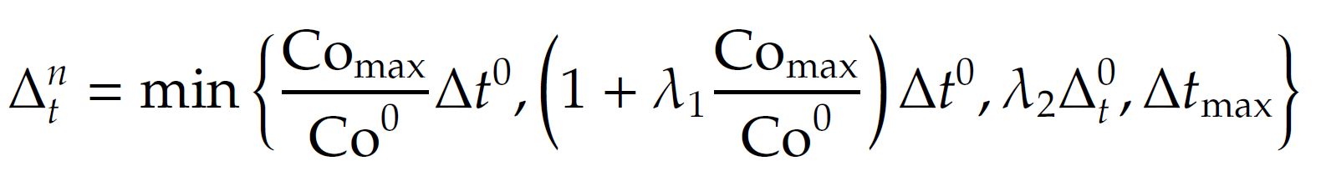
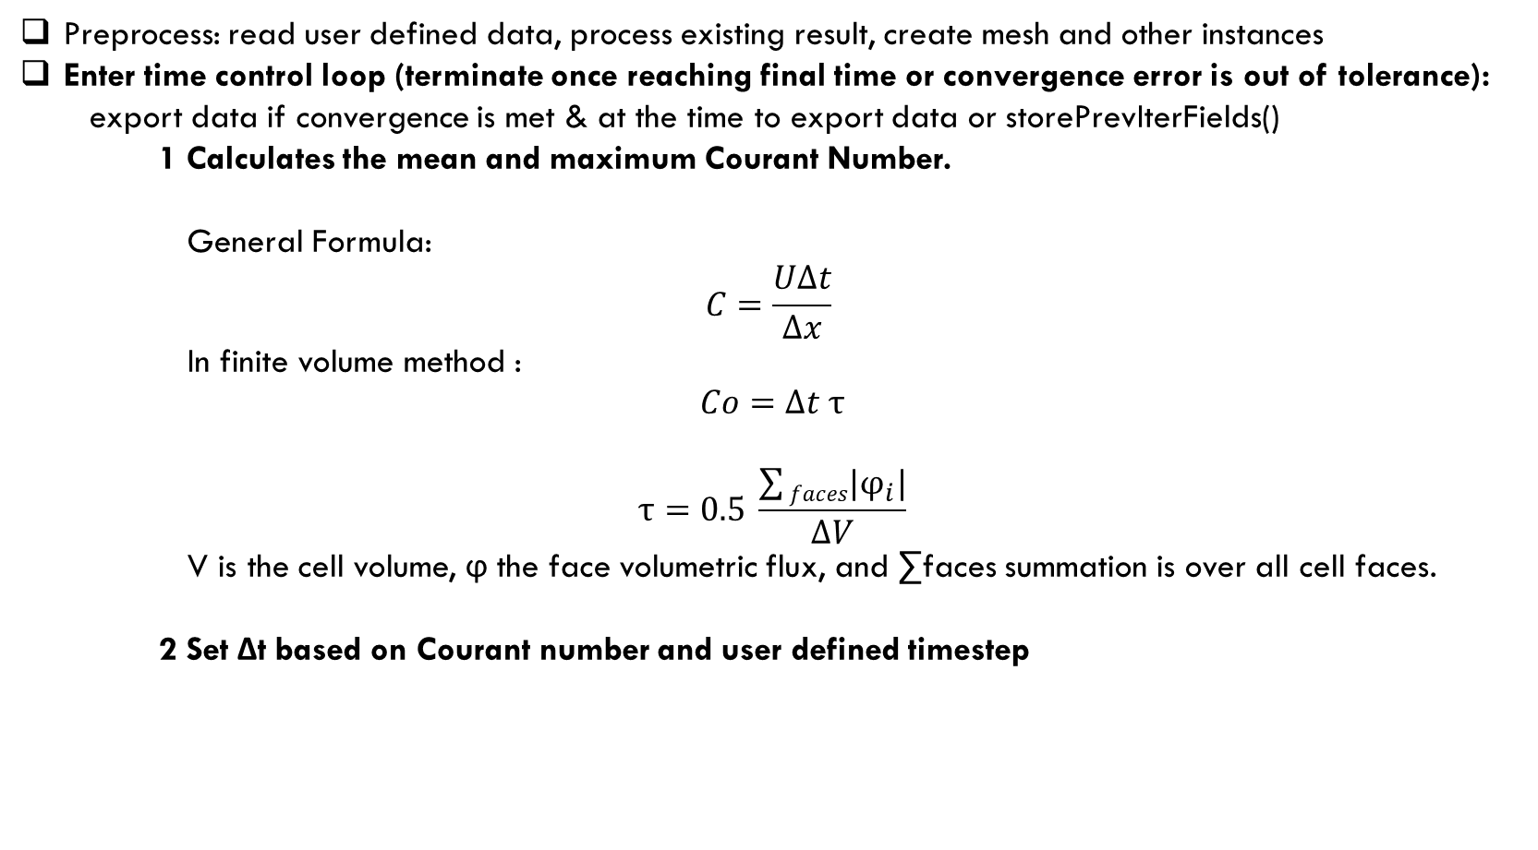
Solving Process
Preprocess: read user defined data, process existing result, create mesh and other instances
Enter time control loop (terminate once reaching final time or convergence error is out of tolerance):
export data if convergence is met & at the time to export data or storePrevIterFields()
1 Calculates the mean and maximum Courant Number.
General Formula:
$$C=\frac{UΔt}{Δx}$$
In finite volume method :
$$Co=Δt τ$$
$$τ=0.5 \frac{\sum{faces|φ_{i}|}}{ΔV}$$
V is the cell volume, ϕ the face volumetric flux, and ∑faces summation is over all cell faces.
2 Set Δt based on Courant number and user defined timestep

Slide 16
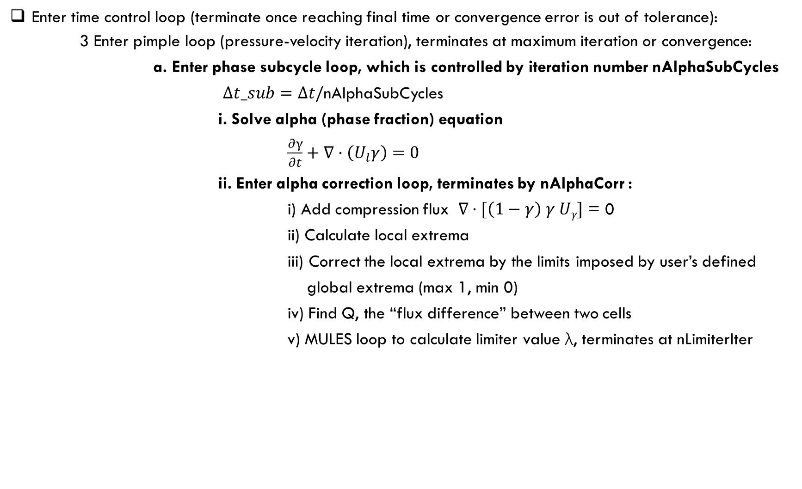
Solving Process
Enter time control loop (terminate once reaching final time or convergence error is out of tolerance):
3 Enter pimple loop (pressure-velocity iteration), terminates at maximum iteration or convergence:
a. Enter phase subcycle loop, which is controlled by iteration number nAlphaSubCycles
$Δt_sub=Δt/$nAlphaSubCycles
i. Solve alpha (phase fraction) equation
$\frac{∂γ}{∂t}+∇·\left(U_{l}γ\right)=0$
ii. Enter alpha correction loop, terminates by nAlphaCorr :
i) Add compression flux $∇·[\left(1−γ\right) γ Uγ]$ = 0
ii) Calculate local extrema
iii) Correct the local extrema by the limits imposed by user’s defined global extrema (max 1, min 0)
iv) Find Q, the “flux difference” between two cells
v) MULES loop to calculate limiter value λ, terminates at nLimiterIter

Slide 17

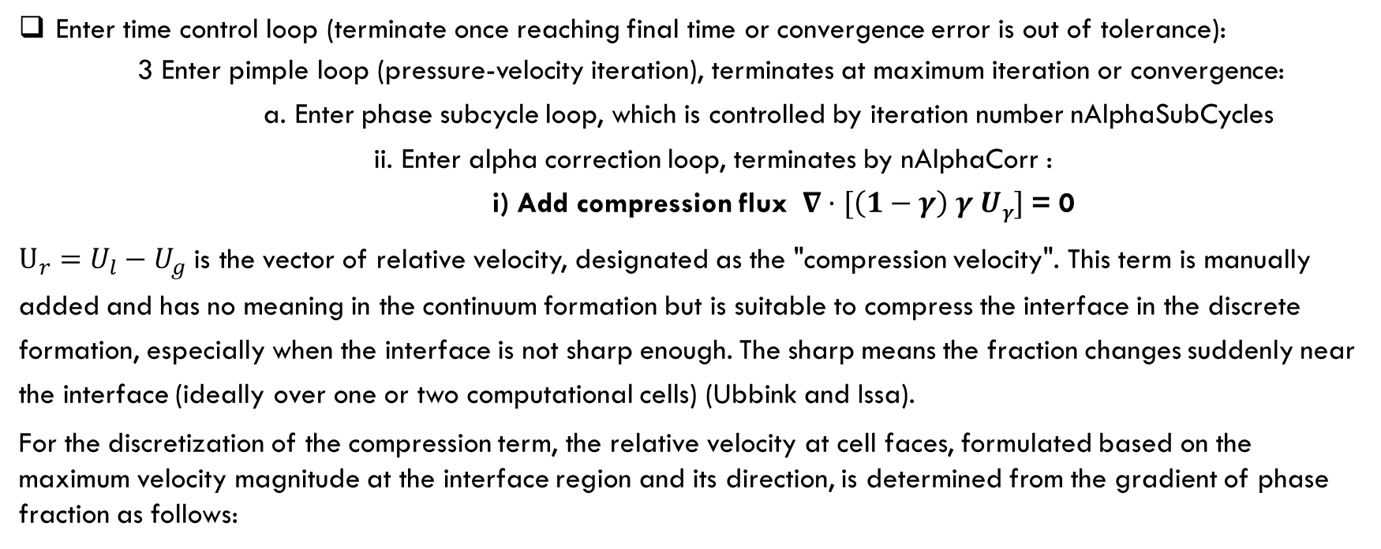
Solving Process
Enter time control loop (terminate once reaching final time or convergence error is out of tolerance):
3 Enter pimple loop (pressure-velocity iteration), terminates at maximum iteration or convergence:
a. Enter phase subcycle loop, which is controlled by iteration number nAlphaSubCycles
ii. Enter alpha correction loop, terminates by nAlphaCorr :
i) Add compression flux $∇·[\left(1−γ\right) γ Uγ]$ = 0
$U_{r}=U_{l}−U_{g}$ is the vector of relative velocity, designated as the "compression velocity". This term is manually added and has no meaning in the continuum formation but is suitable to compress the interface in the discrete formation, especially when the interface is not sharp enough. The sharp means the fraction changes suddenly near the interface (ideally over one or two computational cells) (Ubbink and Issa).
For the discretization of the compression term, the relative velocity at cell faces, formulated based on the maximum velocity magnitude at the interface region and its direction, is determined from the gradient of phase fraction as follows:

Slide 18


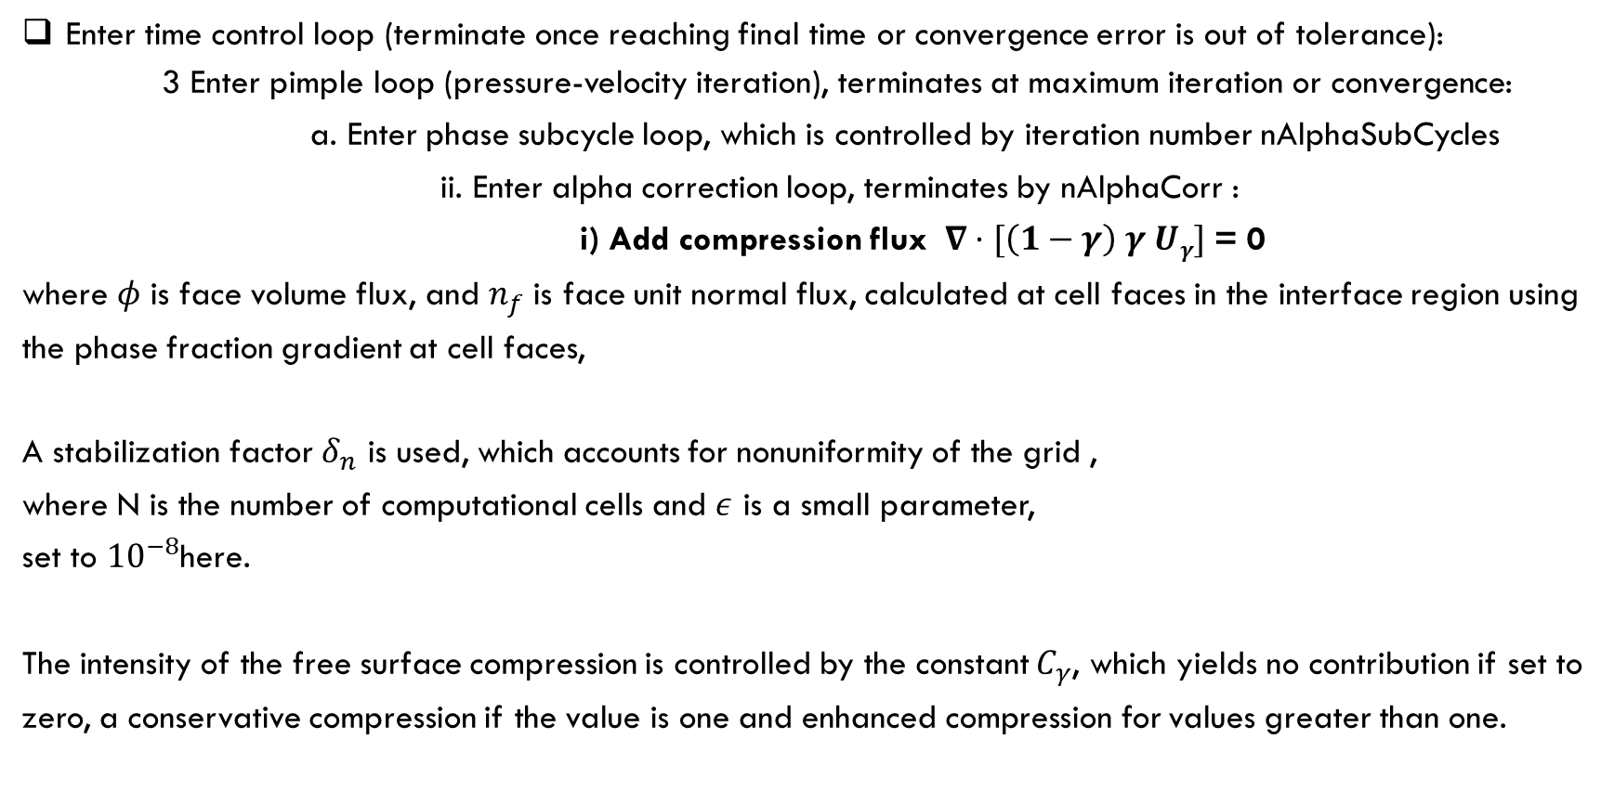
Solving Process
Enter time control loop (terminate once reaching final time or convergence error is out of tolerance):
3 Enter pimple loop (pressure-velocity iteration), terminates at maximum iteration or convergence:
a. Enter phase subcycle loop, which is controlled by iteration number nAlphaSubCycles
ii. Enter alpha correction loop, terminates by nAlphaCorr :
i) Add compression flux $∇·[\left(1−γ\right) γ Uγ]$ = 0
where $φ$ is face volume flux, and $n_{f}$ is face unit normal flux, calculated at cell faces in the interface region using the phase fraction gradient at cell faces,
A stabilization factor $δ_{n}$ is used, which accounts for nonuniformity of the grid ,
where N is the number of computational cells and $ε$ is a small parameter,
set to ${10}^{−8}$here.
The intensity of the free surface compression is controlled by the constant $C_{γ}$, which yields no contribution if set to zero, a conservative compression if the value is one and enhanced compression for values greater than one.

Slide 19

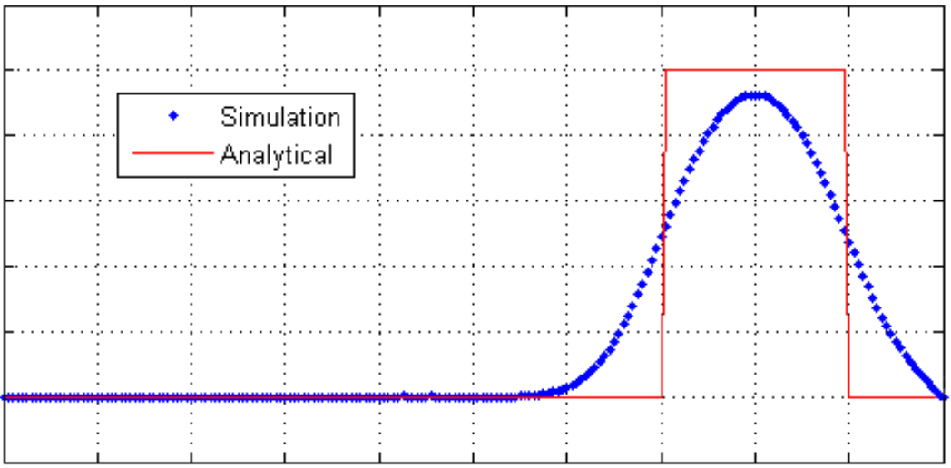
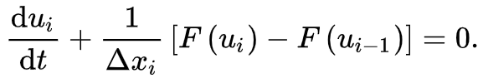
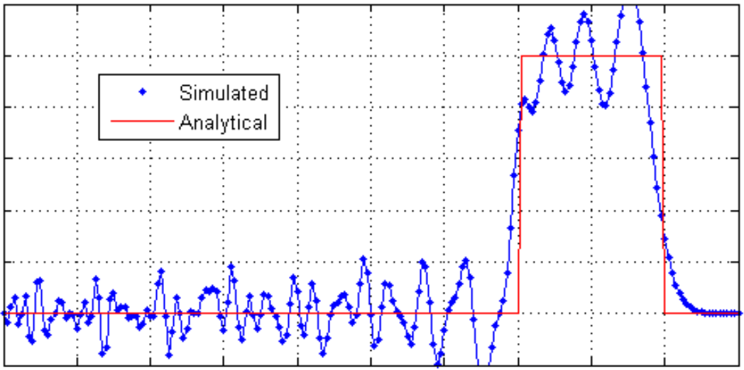
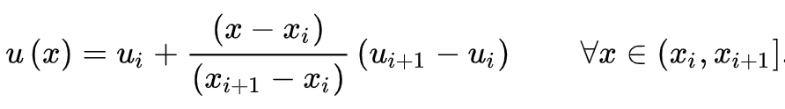
Solving Process
Enter time control loop (terminate once reaching final time or convergence error is out of tolerance):
3 Enter pimple loop (pressure-velocity iteration), terminates at maximum iteration or convergence:
a. Enter phase subcycle loop, which is controlled by iteration number nAlphaSubCycles
ii. Enter alpha correction loop, terminates by nAlphaCorr
v) MULES loop to calculate limiter value λ, terminates at nLimiterIter
Consider partial derivative equation:
Discretization with first order accuracy in space, which has low accuracy:
Discretization with second order accuracy in space, which will induce
spurious oscillations:

Slide 20
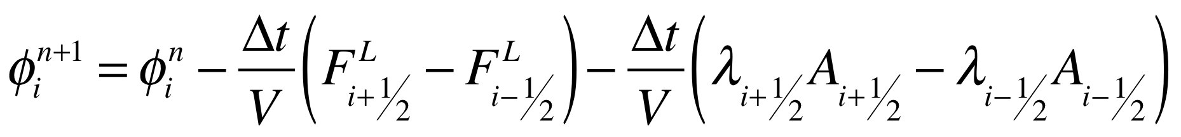
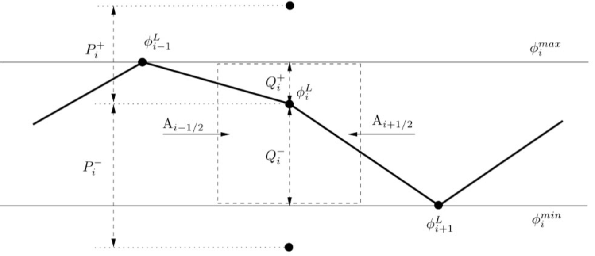
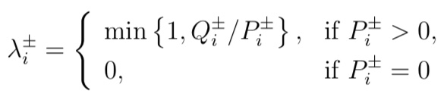
Solving Process
Enter time control loop (terminate once reaching final time or convergence error is out of tolerance):
3 Enter pimple loop (pressure-velocity iteration), terminates at maximum iteration or convergence:
a. Enter phase subcycle loop, which is controlled by iteration number nAlphaSubCycles
ii. Enter alpha correction loop, terminates by nAlphaCorr
v) MULES loop to calculate limiter value λ, terminates at nLimiterIter
Consider the mixture (Flux-Corrected Transport Scheme):
A value of λ = 1, converts the flux calculation into a higher order estimation. But higher order schemes can lead to spurious oscillations in the result. To avoid creating new local maxima or minima (oscillations), a value of λ between 0 and 1 is chosen for each cell. This choice is dependent on the amount of overshoot, a pure high order scheme would cause compared to a lower order bounded scheme, as depicted in the simplified figure.
OpenFOAM implementation of FCT theory is called MULES (Multidimensional Universal Limiter for Explicit Solution). It is used to solve a convective-only transport equation using an explicit universal multi-dimensional limiter.

Slide 21
Solving Process
Preprocess: read user defined data, process existing result, create mesh and other instances
Enter pimple time control loop (terminate once reaching final time or convergence error is out of tolerance):
3. Enter pimple loop (pressure-velocity iteration), terminates at maximum iteration or convergence:
b. Solve semi discretized velocity equation
fvVectorMatrix UEqn
(
fvm::ddt(rho, U) + fvm::div(rhoPhi, U) //advection term
+ MRF.DDt(rho, U) // Multiple Reference Frame
+ turbulence->divDevTau(rho, U) // diffusion term
==
fvOptions(rho, U)
// fvOptions is an object of Foam::fv::optionList class. It has operator () to add source defined in fvOptions file:
//Info<< "Applying source " << source.name() << " to field "<< fieldName << endl;
);
UEqn.relax(); //the relaxation factor is 1 in fvSolution for transient flow
fvOptions.correct(U); //correct field based on source defined in system

Slide 22
Solving Process
Preprocess: read user defined data, process existing result, create mesh and other instances
Enter pimple time control loop (terminate once reaching final time or convergence error is out of tolerance):
3. Enter pimple loop (pressure-velocity iteration), terminates at maximum iteration or convergence:
c. Enter piso control loop (iterate to get pressure), terminates at maximum iteration times:
i. Solve the pressure equation (with surface tension term)
ii. Obtain flux that obeys continuity equation (velocity)

Slide 23
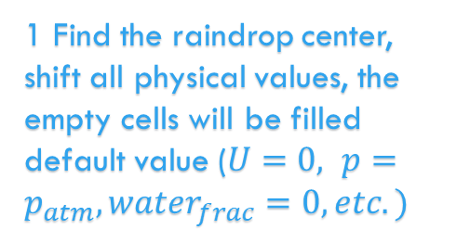
Sliding Mesh
Preprocess: read user defined data, process existing result, create mesh and other instances
Enter pimple time control loop (terminate once reaching final time or convergence error is out of tolerance):
1. Calculates the mean and maximum Courant number.
2. Set Δt based on Courant number and user defined timestep
3. Enter pimple loop (pressure-velocity iteration), terminates at maximum iteration or convergence:
a. Enter phase subcycle loop, which is controlled by iteration number nAlphaSubCycles
i. Solve alpha (phase fraction) equation
ii. Enter alpha correction loop, terminates by nAlphaCorr :
phase compression & MULES algorithm
b. Solve semi discretized velocity equation
c. Enter piso control loop (iterate to get pressure), terminates at maximum iteration times:
i. Solve the pressure equation (with surface tension term)
ii. Obtain flux that obeys continuity equation (velocity)
d. recalculate turbulence related term (not included so far)
4. Export output
1 Find the raindrop center, shift all physical values, the empty cells will be filled default value ($U=0, p=p_{atm}, water_{frac}=0, etc.)$
2 Store all calculated values (raindrop velocity, raindrop location, falling distance

Slide 24
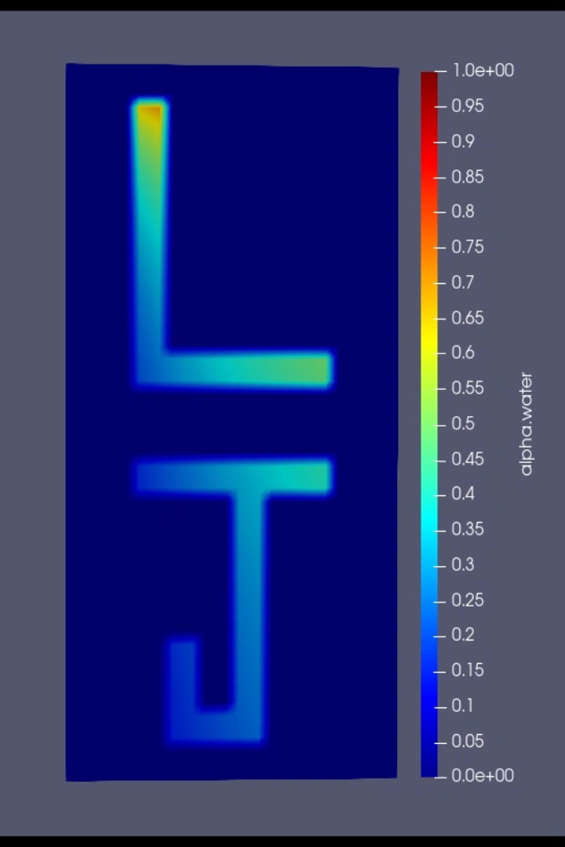
Demo of Modifying Codes

